Slide 1
Start College
Before College
CHAPIN HIGH SCHOOL

Slide 2
Advanced Course Opportunities for Students
Advanced Placement Dual Credit OnRamps
College Board El Paso Community College UT Austin/UT Tyler
No test score eligibility Test score eligibility No test score eligibility
Exam score of 3 to 5 Earn credit with a 70 Opt for college credit
*Advanced courses can help raise GPA
*Earning college credit while in high school can save the student
time and money in the future

Slide 3
PART 1
PROGRAM OVERVIEW
The Dual Credit Program provides an opportunity for qualified high school students to enroll in college-level courses. Students can earn college credit and high school credit at the same time by taking EPCC classes at their high school campus.

Slide 4
Dual Credit Program: Definition
A program that permits high school juniors and seniors to enroll in college courses before high school graduation
College Course held here at Chapin or at CCTE
The grade they earn will fulfill both
High School Transcript + College Transcript

Slide 5
Minimum Requirements
Academic
In 10th grade or 11th grade
80+ high school average
The Texas Success Initiative (TSIA2) is a program designed to determine if a student is ready for college-level course work by assessing the student’s skills in reading, writing and math. The test scores determine eligibility into college-level classes.

Slide 6
Student can be eligible for Dual Credit courses through:
TSI test scores
STAAR EOC test scores Algebra 1
STAAR EOC test scores English 2
PSAT/NMSQT test scores
SAT test scores
ACT test scores
College Readiness Testing Sophomore Year
*TSIA2 (ELAR) Writing & Reading during fall semester
*TSIA2 Math during spring semester.

Slide 7
TSI Test Results Fall 2020
*Minimum Score Essay 4 - Writing 340* *Minimum Score Reading 351* *Minimum Score Math 350*
English 3 DC US History Pre-Calculus
Psychology
College Transition
Astronomy

Slide 8
New version: TSIA2 Test Results Spring 2021
*Minimum Score on the ELAR* of 945 and essay score of 5 or
A score between 910 and 944, essay score of 5 and Diagnostic score of 6
English 3 DC US History Pre-Calculus
Psychology College Transition
Astronomy
*Minimum Score on the Math* of 950 or between 910 and 940 and Diagnostic score of 6
Pre Calculus

Slide 9
Conditions of Enrollment
How many DC Courses can you take per year?
No limit to the number of courses
Recommended 2 courses per year
Three courses recommended if you have a 3.0 High School GPA or higher
The student must have and maintain a 2.0 (70%) college GPA to continue taking DC courses.

Slide 10
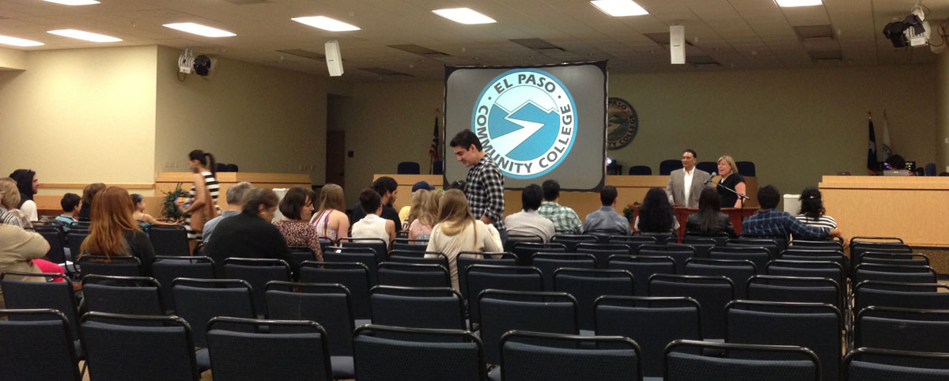
College Culture
The courses will be COLLEGE courses….
…….. With COLLEGE expectations
What does that mean?

Slide 11
High School College
Often no textbook Textbook/reading required
Light homework load Heavy homework load
Many grades Fewer grades
Absence policy lenient Absence policy NOT lenient
School info given to parents School info NOT given to parents

Slide 12
How is college credit earned?
In a DC class, students earn college credit upon successful completion of the course at the end of each semester/term. It is crucial to strive for an "A" or "B" in the course, all grades will be reflected on the college transcript. Grades acquired in dual credit courses may affect college cumulative GPA, depending on the future institution you attend.

Slide 13
What do I do with the college credit I earned?
Submit a transcript request form to EPCC to send a transcript to your college for review.
Email the transcript request to epaiz@epcc.edu. Form can be found on EPCC website or can pick one up in the C5 lab.
College counselor can assist with this process.

Slide 14
Scholarship Opportunity for DC students
STARS SCHOLARSHIP FUND
www.starsscholarship.org
Completed 12 undergraduate college hours
2.7 GPA
US Citizenship or Legal Residency
Resident of south or west Texas

Slide 15
What do I do with my TSI scores?
TSI scores should be sent to college to be placed in college readiness courses instead of developmental classes.
UTEP can access scores with a permission to release scores filled out by student and/or parent.
Other universities may have a different process.
Please keep a copy of your scores.
College readiness standards may be raised by the time your child reaches college and may need to retest.

Slide 16
Part 2
RISK AND REWARDS

Slide 17
Risks
If a dual credit student withdraws (drops) from a course before the Census Date, the course will not appear on the EPCC transcript. It is the responsibility of the student to check with the instructor or their course syllabus for the Census Date. Students who withdraw (drop) from a course on or after the census date will receive a “W” on their EPCC transcript. Having “W’s” on college transcripts may impact Federal Financial Aid eligibility after graduation from high school.
Students must maintain a minimum EPCC GPA of 2.0 (70%) to remain in the course.
Instructor’s can withdraw a student from a course if they determine that he/she has ceased to pursue the course objectives as stated in the course syllabus.
If you earn a D or F in a dual credit course (and meet the minimum EPCC GPA requirement), an EPCC Committee will determine if the student may continue in the dual credit program. That D or F will remain on the college transcript.
Credit received from EPCC may or may not be accepted by other colleges or universities, and it is the responsibility of the student to research this information as is varies by institution.

Slide 18
What does this mean?
Do some research before choosing courses.
Math and Science courses require students to attend lab sessions outside of the school day.
Try to select courses in your future degree plan/core.
Take all dual credit courses seriously.
Do not overload your schedule with college courses.
Explore the options, including tutoring, before dropping a course.

Slide 19
Potential Benefits
STUDENTS
• gain valuable college experience.
• may shorten time to earn a degree.
• may reduce freshman course load.
• may lower the cost of a higher education.
• may earn weighted high school grades.

Slide 20
Part 3
How to Enroll
.

Slide 21
Chapin Dual Credit Process
Students receive information through English 2 class in the fall.
TSI assessments are administered for Reading and Writing in the fall.
TSIA2 Math assessment is administered in the spring.
Student expresses interest through their test proctor.
Student applies to El Paso Community College.
Student turns in signed documents to DC Counselor
*Signed Early Admissions Form (EPCC)
*Signed DC Parent/Student Agreement (CHS)
7. Counselor enrolls and schedules courses for next year.

Slide 22
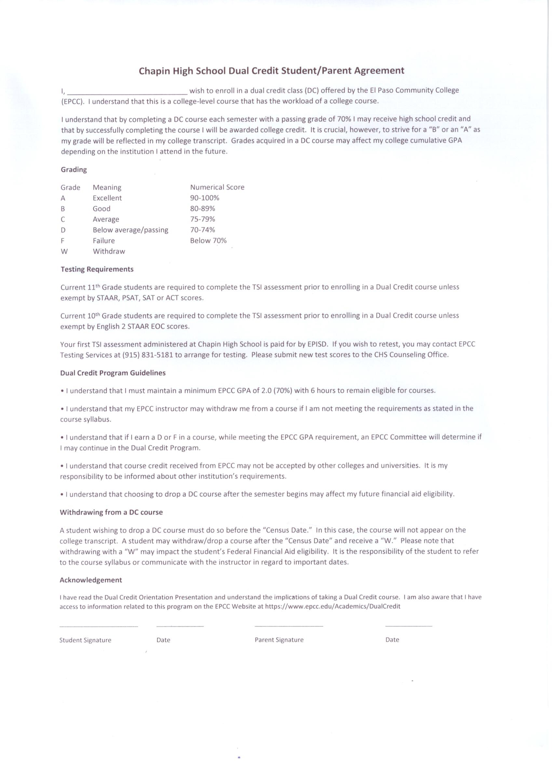
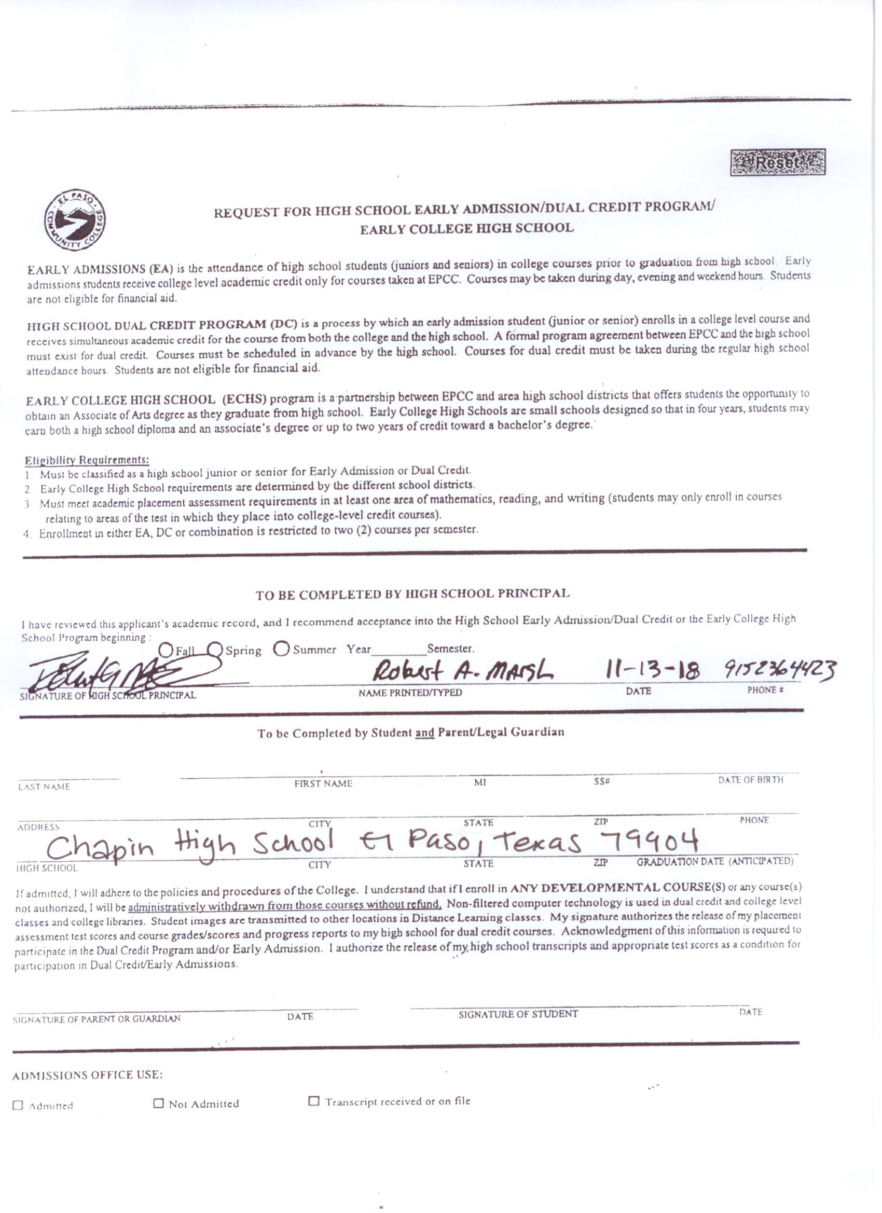
CHS
Student/Parent
Agreement
EPCC
Early Admissions
Form

Slide 23
Stay informed
Keep an eye out for information on ChapinCounselingCenter.weebly.com
Get reminders on test dates and All Dual Credit information including census dates.
Sign up for Remind
In the message box type:@chshuskydc

Slide 24
Important Contact Information
Candice Marrufo, Assistant Principal for Dual Credit
236-4405, camarruf@episd.org
Omar Munoz, CHS Counselor for Dual Credit
236-4450, ojmunoz@episd.org
Diana Medina, EPCC Counselor for Dual Credit
831-2464

Slide 25
EPCC Resources
New Student Orientation in the fall
https://www.epcc.edu/Academics/DualCredit
https://www.epcc.edu/Academics/DualCredit/parents

Slide 26
Questions ?

